Slide 1

Content Authentication and Tamper Detection in Digital Videos
Under the Guidance of : Rahul Gupta (RIT2011050)
Dr. Vrijendra Singh Amit Kumar (RIT2011051)
I.I.I.T.A Prashant Joshi (RIT2011056)
Prakhar Solanki (RIT2011076)
Akshay Gupta (RIT2011088)
Indian Institute of Information Technology, Allahabad

Slide 2
INTRODUCTION
Content authentication is a process by which a user is guaranteed that video content is original and has not been maliciously modified. One example is surveillance and site monitoring footage where incentives exist to remove Incriminating material. The amount of digital video that is available has increased the last few years, but the tools available for browsing video remain quite primitive. As video is transported across networks there is a need for authentication as data changes hand.
When the locations of scene breaks are known, knowledge about scene breaks can be used to look for higher level structures such as a sequence of cuts between cameras or to ensure that key frames come from different scenes. In most of the cases, where a manual human observer can give fast and accurate decision are still beyond the reach of most efficient and best Video Analytics systems.

Slide 3
Problem Definition
Now days there are lots of software’s available in the market
for editing videos.
We are, through this project, trying to identify whether there
is a tempering done in the given video or not.
There are many ways in which a video can be tempered-
1. Cutting
2. Fading:
2.1. Fade in
2.2. Fade out
3. Inserting a Frame
3.1. Insert a different frame into a video somewhere in between a video
3.2. Dissolve a frame in video

Slide 4
1. Cutting:
When a frame or a sequence of frames is removed from video then this type of tempering is known as cutting. This causes a sudden change in intensity and hence in pixel values, so it can easily be identified by looking at pixel change.
2.Fading:
When a frame is slightly inserted or removed so that user may not see the drastic change between the two frames then such type of tempering is known as fading.
There are two types of fading:
2.1 - Fade In:
When a frame is slightly inserted into the video, then this type of tempering is called fade in.
2.2 - Fade Out:
When a frame is slightly removed from the video, then this type of tempering is known as fade out.

Slide 5
3. Frame Insertion:
There are two types of frame insertion:
3.1. When a new or different frame is inserted into a video at any place that comes under frame insertion tempering. In this case, like in cutting tempering, a sudden change in intensity in pixel values can be observed and hence can be detected easily
3.2. Dissolve:
When a frame is smoothly replaced by another one or sequence of frames is inserted in order to insert a frame so that there is not a big change in pixel values between two consecutive frames. This type of tempering is known as dissolved tempering.

Slide 6
MOTIVATION
There’s a need for authenticating a digital video by giving the following examples:
1.) A video clip can be doctored to defame a person. On the other hand, criminals get away from being punished because the video showing their crime can’t be proved trustworthy in the court of law.
2.) In surveillance systems, it is hard to reassure that the digital video produced as evidence is the one that is actually shot by the camera.
3.) A journalist cannot prove that the video played by a news channel is trustworthy.
4.) A video viewer who receives video through a communication channel cannot ensure that video being viewed is really the one that was transmitted.
So there is a compelling need for video, wherever it is and in whatever form it is, be made authenticable before use.

Slide 7
Proposed Approach
Since during an insertion or dissolve, new intensity edges appear far from the location of old edges. Similarly, old edges disappear far from the location of new edges. We define an edge pixel that appears far from an existing edge pixel as an entering edge pixel, and an edge pixel that disappears far from an existing edge pixel as an entering pixel.
In this approach we first take two consecutive frames from video, let that be A and B, then applying edge detection technique we generate two corresponding binary images let I, I’. Let the po be the fraction of exiting edge pixel and pi be the fraction of entering edge pixel. We define p= diff(pi,po) as the fraction of changed edges, Which will be the basis of measuring dissimilarity between two images. An insertion of frame or dissolve can be detected by looking at peak value of p.

Slide 8
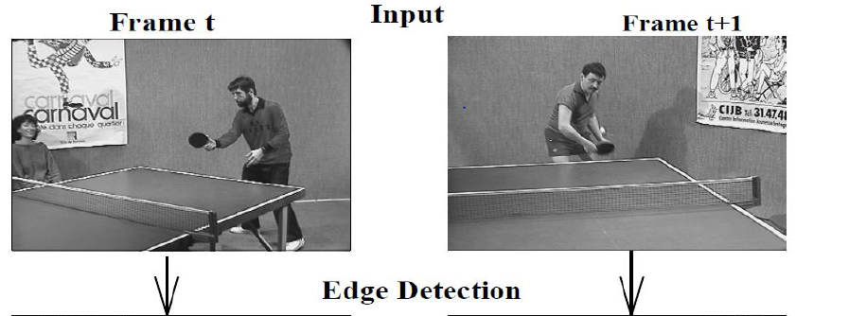
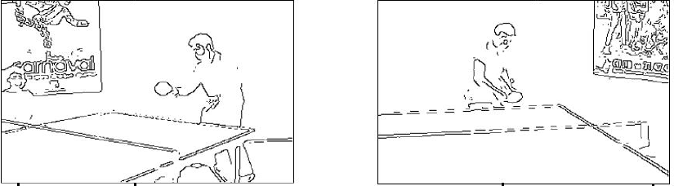
EDGE DETECTION

Slide 9
Finding edge change fraction
In this method we first detect edges of frames using existing edge detector algorithm .We next compute the gradient magnitude which indicates how fast the local intensities are changing. The gradient magnitude is thresholded at a value of to detect edges.
Next two copies of I and I’ are created Ī, Ī’ with each pixel is dilated by r. Thus image Ī is a copy of I which each pixel is replaced by a circle of radius r.
Let pi be the pixels which are present in present ie ith frame but were absent in (i-1 )th frame. Let po be the pixels which were present in (i-1)th frame but are not present in current ie ith frame.
Change fraction is given by diff (po-pi).

Slide 10
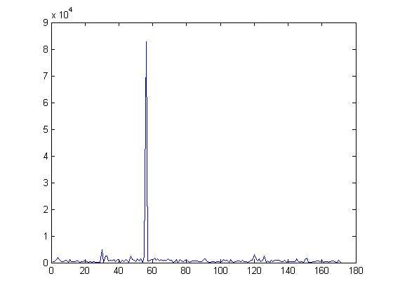
Detecting peaks

Slide 11
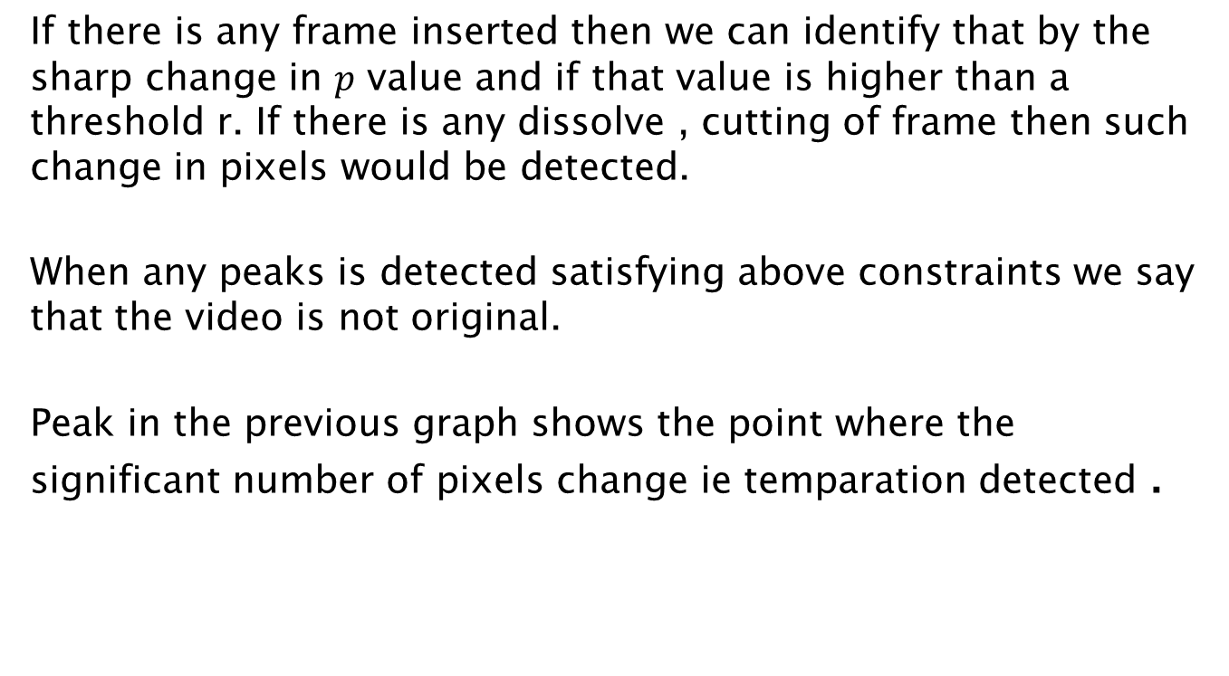
Detecting peaks
If there is any frame inserted then we can identify that by the sharp change in $p$ value and if that value is higher than a threshold r. If there is any dissolve , cutting of frame then such change in pixels would be detected.
When any peaks is detected satisfying above constraints we say that the video is not original.
Peak in the previous graph shows the point where the significant number of pixels change ie temparation detected .

Slide 12
Authenticating the video
Watermarking is a technique used to hide data or identifying information within digital multimedia. Watermarking is becoming popular, especially for adding undetectable identifying marks, such as author or copyright information.
Watermarking techniques can be classified as:
Text Watermarking
Image Watermarking
Audio Watermarking
Video Watermarking
In other way, the digital watermarks can be divided into three different types as follows:
Visible watermark
Invisible-Robust watermark
Invisible-Fragile watermark

Slide 13
Authenticating the video
LSB watermarking
The idea behind this watermarking technique is the following: if you see you image as a matrix NxM (where N and M are the dimension of the image) you can represent the value of the pixel in the position (i,j) as a binary number; this binary can be then divided in all of its bit, so that you will have a most significant bit (the one that contains quite a lot of information, and a least significant bit that contains few information).
If your image is for example in gray scale, you can make changes to the value of the LSB without any perceptible distortion for the human user therefore you can think of taking the LSB of an image (the cover image) and change its value in every pixel with the MSB of another image, that we would like to embed in a secret/non perceptible way in the cover image).

Slide 14
Hardware and Software Used
To be used efficiently, all computer software needs certain hardware components or other software resources to be present on a computer . These prerequisites are known as (computer)system requirements and are often used as a guideline as opposed to an absolute rule.
Hardware requirements
At least 20 GB of hard disk
1 GB or more RAM
Graphics card
Software requirements
windows operating system(Platform)
windows movie maker
matlab (image processing toolbox)
video splitter

Slide 15
Results

Slide 16
Conclusions
Video authentication is a very challenging problem and of high importance in several applications such as in forensic investigations of digital video for law enforcement agencies,
video surveillance and presenting video evidence in court of law. However with growing development in video editing tools and wide availability of these powerful editing software,
video tampering attacks explores new dimensions in various fields. It becomes difficult to deal with the authenticity of raw video sequences.
A practical system of digital video watermarking is suggested for authenticating and tampering detection of compressed videos. To design an efficient and low complexity method, the embedding and extracting of watermarks are integrated with the coding and decoding routines of the video codec

Slide 17
Future Scope
With a wide range of tampering attacks, causes severe challenges on information security.
In future robustness would be the key point for video
authentication techniques, so that it can differentiate the
acceptable video processing operations from malicious
tampering attacks. However A perfect video authentication
algorithm that detects all kinds of malicious manipulations
and that can tolerate all content preserving manipulations is
yet to be discovered. We can hope for the better in the
future
Further work involves modeling and feature extraction from image sequences and videos with multiple tamper attacks.

Slide 18
References
[I] F. Hartung, B. Girod, Watermarking of uncompressed and Compressed Video, Signal Processing 66 (1998), pp.283-301
[2] B. Mobasseri, Direct Sequence Watermarking of Digital Video using m-frames, Proc. IEEE ICIP98, October 4-7, Chicago
[3].B. Mobasseri, A spatial video watermark that survives MPEG , IEEE International Conference on Information Technology: Coding and Computing, March 27-29,2000, Las Vegas
[4] http://www.mathworks.in/
[5] http://www.web.iitd.ac.in/sumeet/Jain.pdf
[6] Digital Image Processing by E. Woods and Gonzalez

